Slide 1

Uppercase and Lowercase Desktop Application
Lecturer :Ms.Lavanya Mohan
Email :lavanya@metaverseage.ae

Slide 2
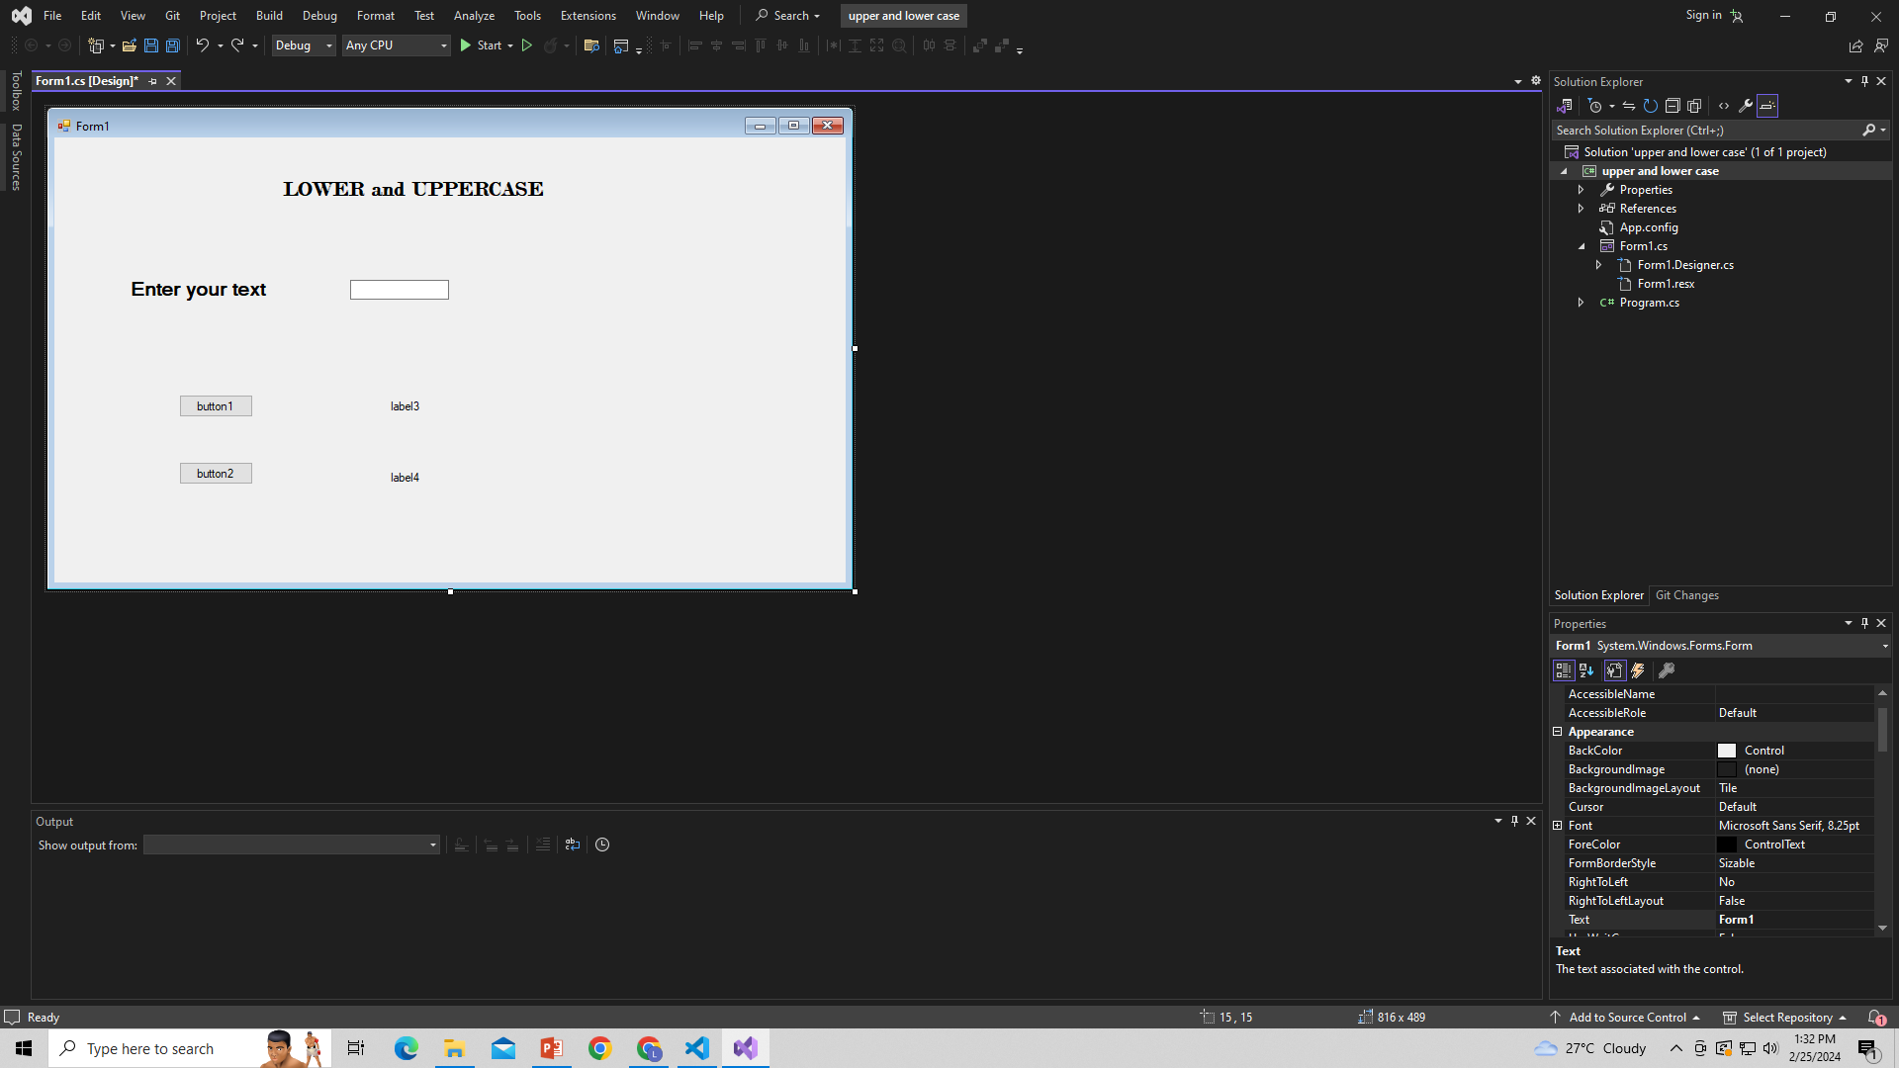
Design your page by using ToolBox
ToolBox

Slide 3
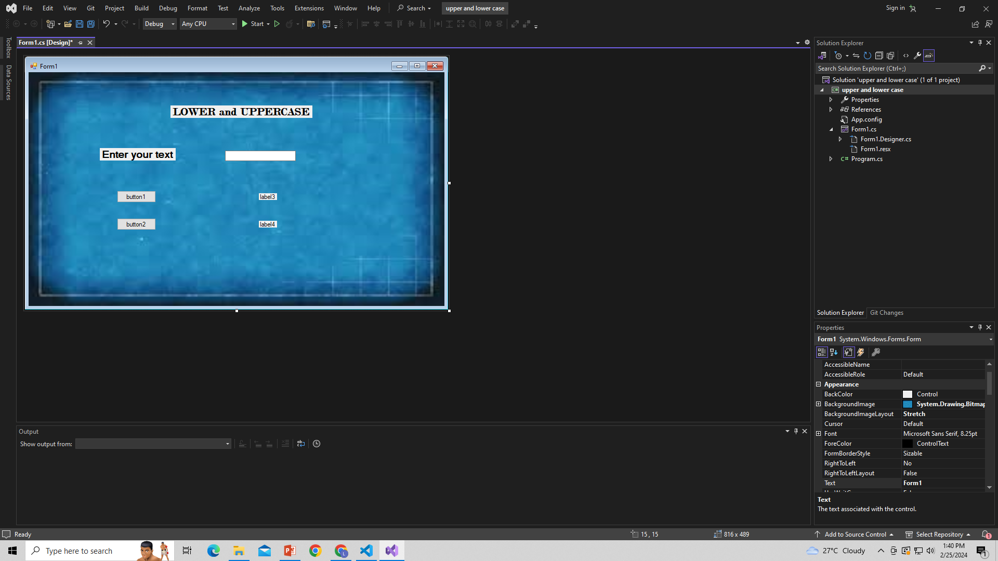
Change background image

Slide 4
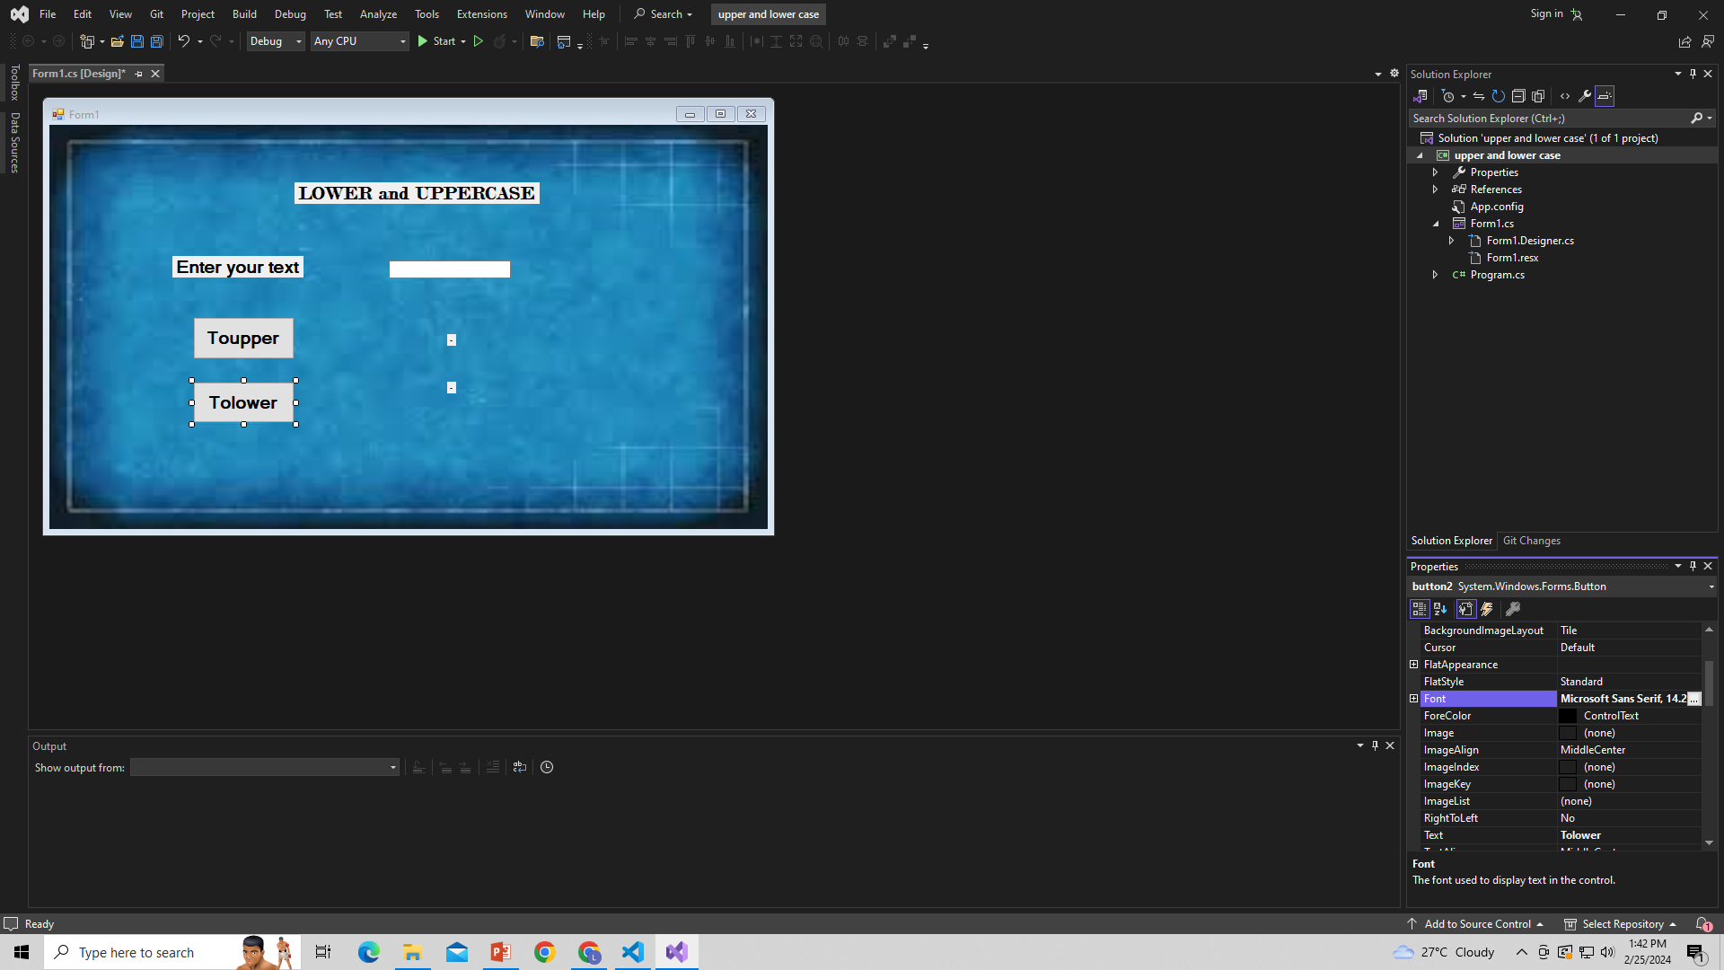
Double Click button and write your code
Button1
Button2

Slide 5
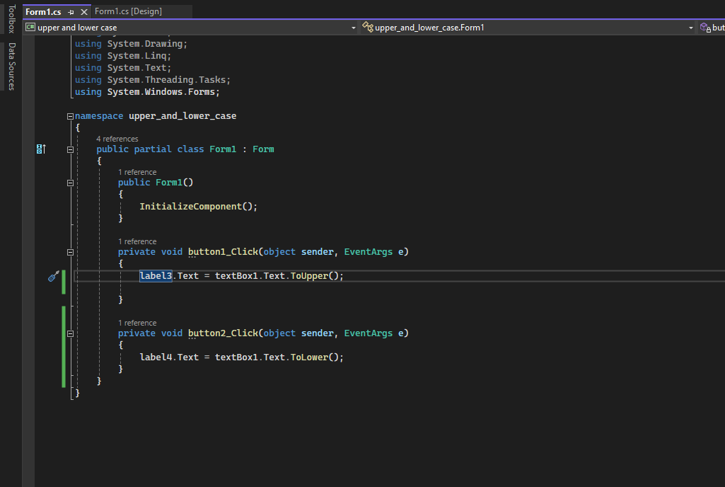

Slide 6
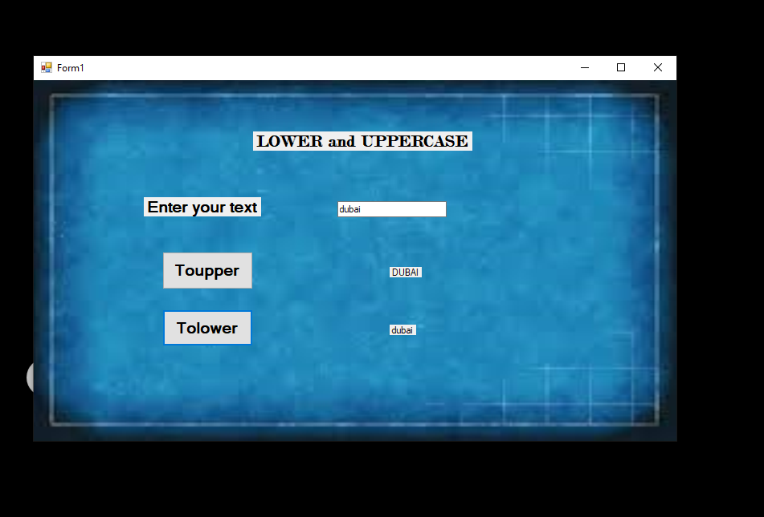
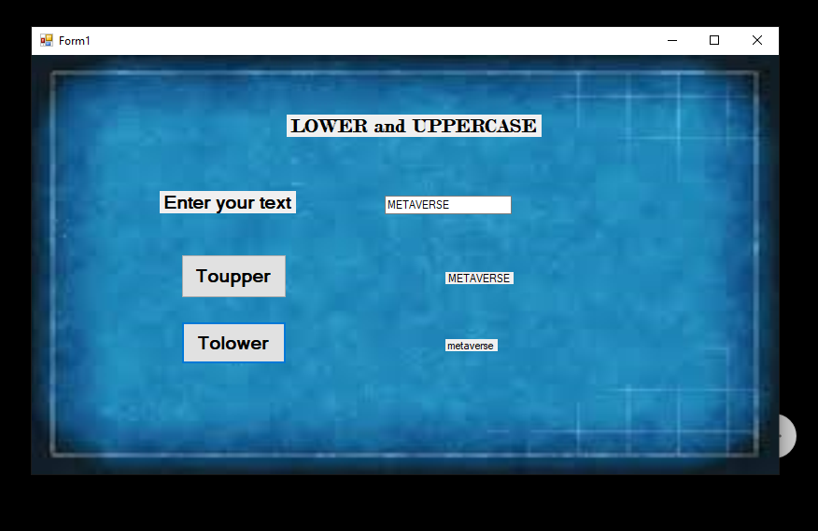
Output

Slide 7
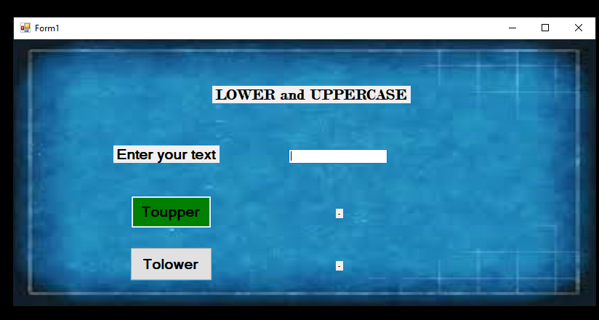
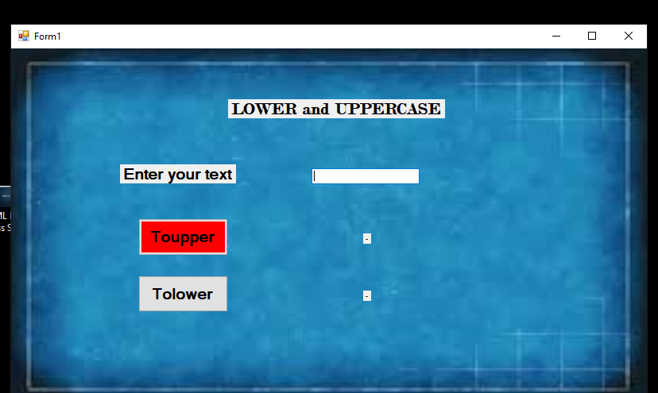
Mouse properties
Mouse Hover()
Mouse Leave()

Slide 8
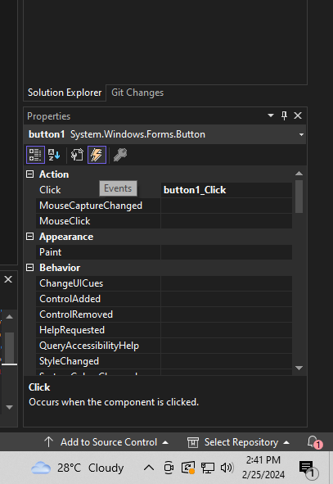

Mouse Hover
Events
Mouse hover
Mouse Leave

Slide 9
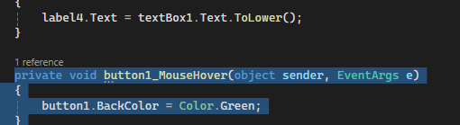
Mouse hover coding

Slide 10
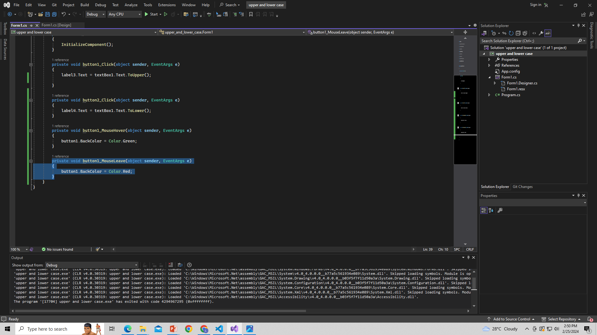
Mouse Leave Coding

Slide 11
Thank You

